Slide 1
Discreet Log Contracts
Team:
Rajneesh Pandey (106119100),
Satyarth Pandey (106119112),
Kartikey Agarwal (106119058)

Slide 2
DLC Definition
Smart contracts in same channel construction as lightning.
Lightning: most recent tx is valid
DLC: non-interactive oracle determines valid tx

Slide 3
Requirements of
Discreet log contracts (DLC)
DLCs are a system which addresses the scalability and privacy concerns and seeks to minimize the trust required in the oracle which provides external data.

Slide 4
Conditional Payments
payment conditional on some external data
Example,
Alice and Bob bet on tomorrow's match result. If INDIA won, Alice gets 1 BTC. Otherwise, Bob gets 1 BTC.
One problem:
The bitcoin blockchain is not aware of the match result or any other external real world data.

Slide 5
Smart contracts and
Oracles
LN (Lightning Network) is a simple script, enforcing the most recent transaction.
Made of smart contracts, but has no external state. Everything comes from Alice & Bob. If we want external state, need some way to get it, usually called an "oracle".
Simple oracle: 2 of 3 multisig

Slide 6
Schnorr Signature
Scheme
public key : A = aG
k <- $; R = kG (nonce for sign)
to sign, compute s = k-h(m, R)a
signature is (R, s)
To verify,
sG =? kG - h(m, R)aG
=? R - h(m, R)A
Given 'pubkey' (A, R) and a message m, you can't compute s.
(EC Discrete log problem) but you CAN compute sG = R - h(m,R)A

Slide 7
Fixed-R signature
Scheme
Schnorr Scheme:
Pubkey: A
signature: (R, s)
Fixed-R scheme:
Pubkey: (A, R)
signature: s

Slide 8
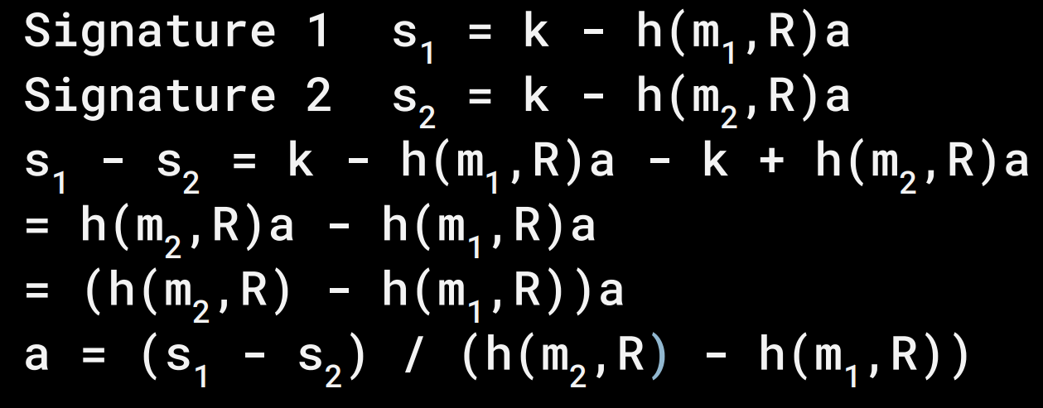
k-collision
This prevents Oracle to give out different results for different contracts.

Slide 9
Signatures as private keys
Olivia chooses s as private key sG as public key Mix with Alice and Bob's public keys.
pub(alice) + sG = pub(contract)
priv(alice) + s = priv(contract)

Slide 10


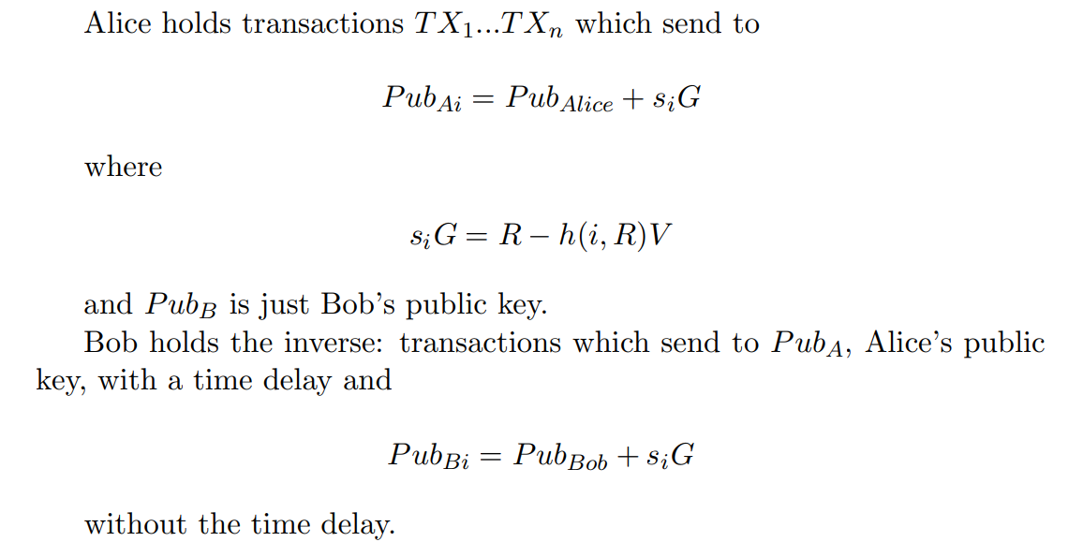
Transactions within the Contract
The script is the same sequence of
opcodes as used in Lightning Network channels. Alice holds
while Bob holds

Slide 11
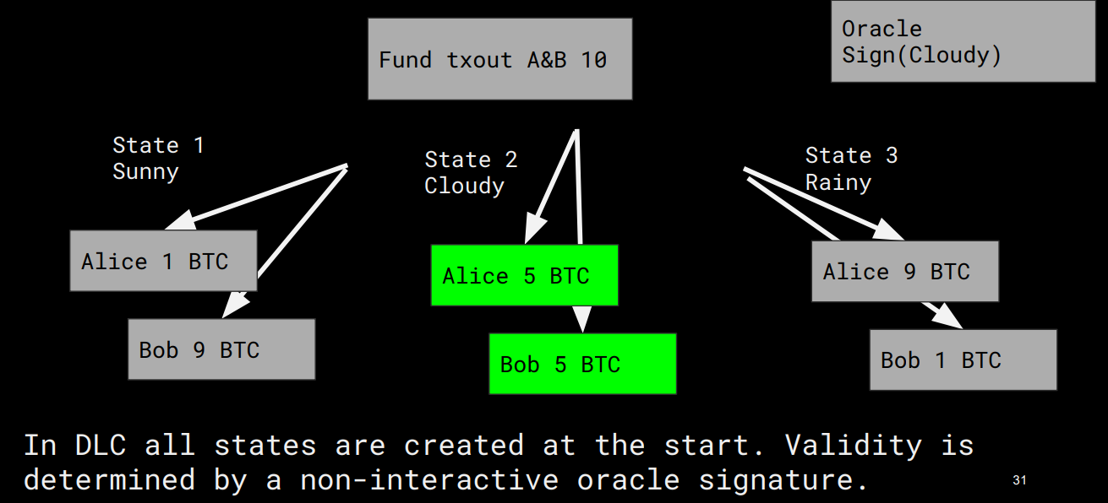

Slide 12
DLC scalability
Can split the R value (and message) in to a R-exponent and R-mantissa.
Helps cut down the off-chain transactions needed in ranges which don't lead to different allocations.

Slide 13
DLC use cases
Currency futures? Stocks?
Commodities? Sports? Insurance?
Pretty general; conditional payments based on any number or element from predetermined set.

